Slide 1
Quantum Error Correction
Philippe Noël, Alaisha Sharma, Nicolas Weninger
ES 170 Final Project
10 May 2018

Slide 2
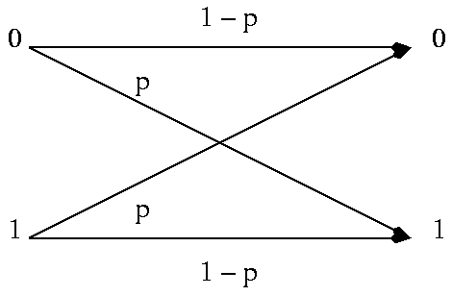
Basis in classical error correction
General idea
Message = bit sequence
Encode a message with some redundancy
Some of the message may be corrupted
Enough redundancy that original message is recoverable
Binary symmetric channel
0 → 000
1 → 111
Because error probability p is small, only single bit likely to be flipped

Slide 3
Challenges with quantum error correction
No cloning states
Repetition codes work for classical bits
Qubits cannot be replicated (would require looking at superposition)
Errors are continuous
Only bit flips can occur on classical bits
Continuum of different errors can occur on qubits (for example, rotating state by any amount)
Cannot determine exactly what error occurred (would require infinite resources)
Measurement destroys information
Can observe classical output before applying correction
Cannot observe (measure) quantum data without collapsing state

Slide 4
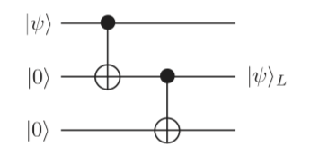

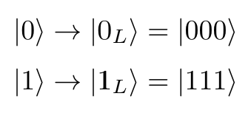
Encoding a logical qubit as 3 qubits
Quantum state is preserved (alpha and beta still unknown)
Redundancy introduced via duplication not repetition
Single “logical” qubit mapped to three qubits

Slide 5
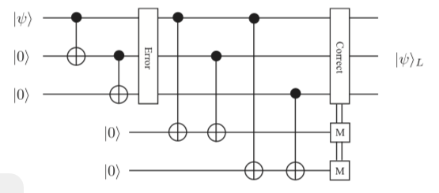
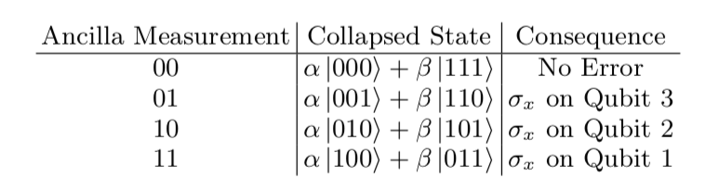
3-qubit error detection for bit flips

Slide 6
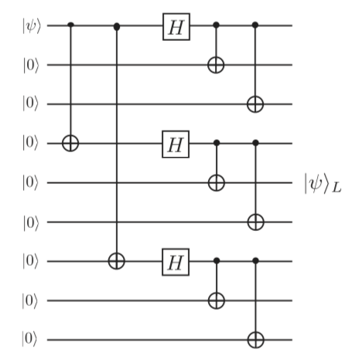
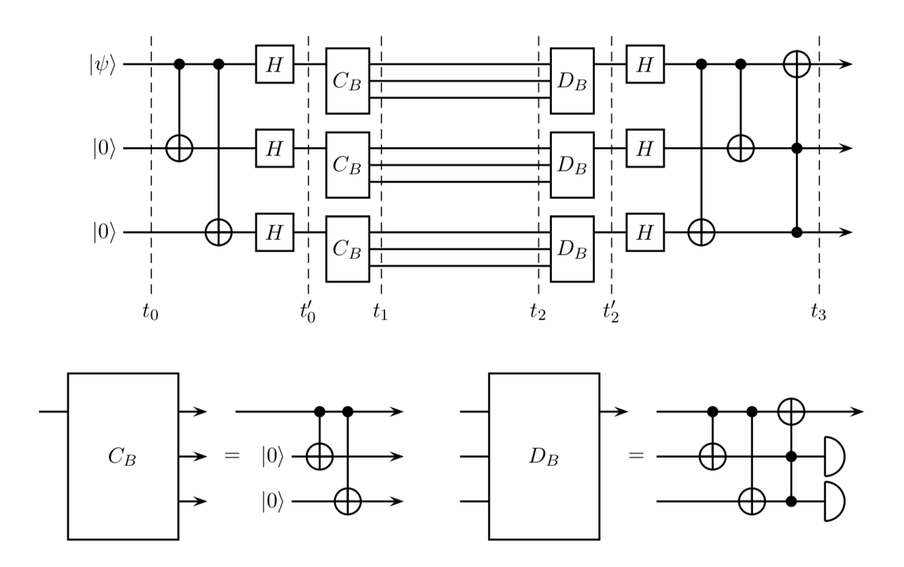
Encoding a logical qubit as 9 qubits

Slide 7
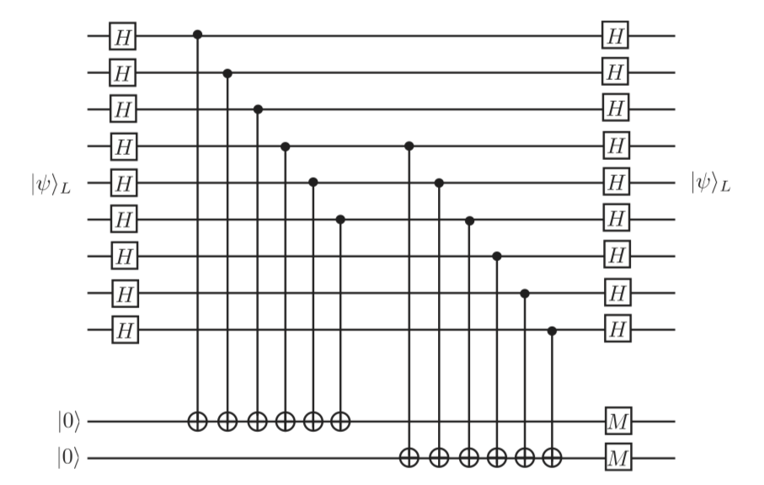
9-qubit error detection using ancilla qubits

Slide 8
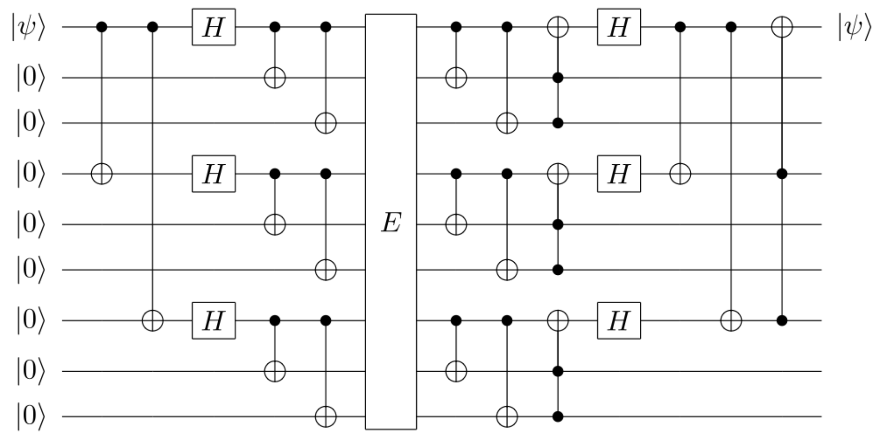
9-qubit error detection without ancilla qubits

Slide 9
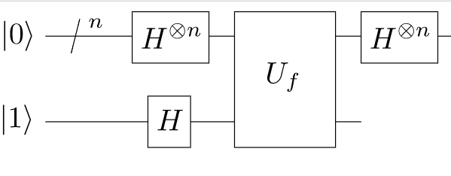
Error correction applied to Deutsch-Josza

Slide 10
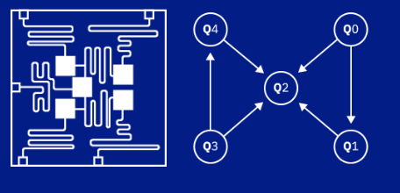
Quantum computing architecture

Slide 11
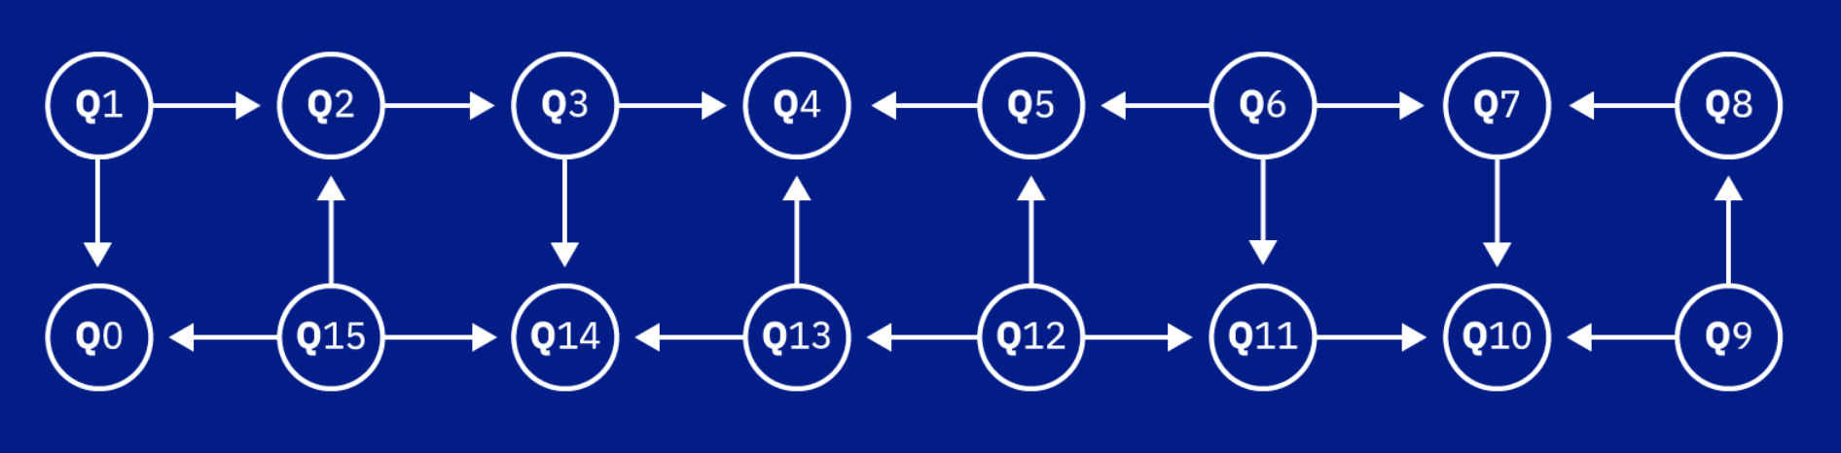
Quantum computing architecture

Slide 12
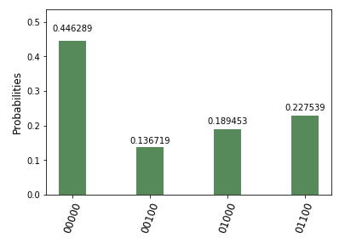
Modern error correction schemes
Assumptions
Perfect gate fidelity
Specific error-prone channel location
Only bit flip (X) and phase flip (Z) errors
Example: 3-qubit control circuit to detect bit flip (no errors introduced) run on IBMQ.
expected state
quantum “noise”

Slide 13
Modern error correction schemes
Solution: Stabiliser Codes!
σ_{z} |0⟩ = |0⟩
Generalisable to topological error correction codes in 2D

Slide 14
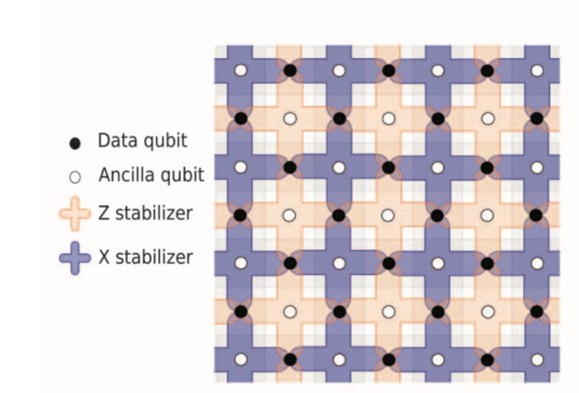
Surface code for bit and phase flips

Slide 15
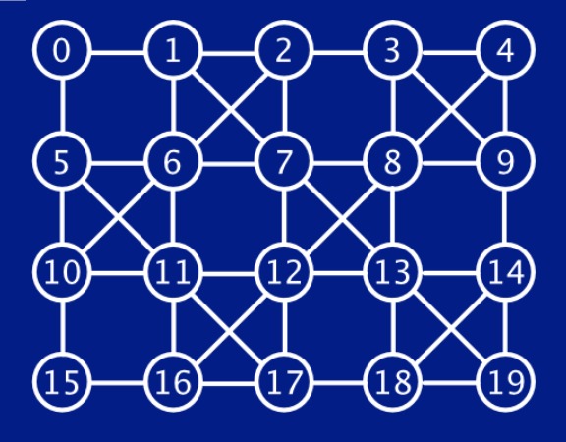
Looking Ahead

Slide 16
Thank you ES 170!

